Slide 1

Training Deep Learning Models to become professional UNO player
Project Group Number: 37
Group Member Details :
Abdul Faisal (0187CS211001)
Danish Khan (0187CS211056)
Azain Khan (0187CS211046)
Guide Details: Anshul Sarawagi

Slide 2
Idea/Approach Details
Abstract:
Our project aims to develop an intelligent agent that learns optimal gameplay strategies using deep learning concepts. The agent is trained using reinforcement learning by playing against predefined rule-based opponents. It interacts with an environment modeled after the UNO card game and refines its decision-making through a reward-based feedback system. The project integrates game logic, a reward function, and a deep learning model to create an adaptive agent capable of competing against human players.
Describe your idea Solution/Prototype here:
The project implements an autonomous UNO-playing agent using Deep Reinforcement Concepts
The environment follows standard UNO game rules, enabling the agent to learn and improve its strategy.
The agent trains against multiple rule-based agents (Random Agent, Strategic Agent) and refines its strategy based on observed outcomes.
A human vs. agent mode allows users to test the trained model interactively.
Describe your Technology stack:
Python
Numpy
PyTorch

Slide 3
Project Requirements
Functional Requirements
To implement we require the following functional requirements:
Implement UNO game logic with reinforcement learning integration.
Develop training and testing environments for the agent.
Enable the agent to make decisions based on a reward function.
Support human vs. agent gameplay for evaluation.
Implement logging and visualization for agent decision tracking.
Non-Functional Requirements
Ensure the system is scalable and extensible for future improvements.
Optimize training performance using GPU acceleration.
Maintain a user-friendly interface for human-agent interactions.
Ensure model efficiency and convergence through optimized hyperparameters.

Slide 4
Project Requirements
Hardware and Software requirements (Developer)
Hardware Requirements:
Processor: Intel i5/i7 or AMD Ryzen 5/7 (or better)
RAM: Minimum 8GB (16GB recommended for training)
GPU: NVIDIA GPU with CUDA support (GTX 1650 or higher recommended)
Storage: 20GB free space for dataset and model file
Software requirements:
Programming Language: Python 3.8+
Deep Learning Framework: PyTorch / TensorFlow
Libraries: NumPy,
Development Tools: Jupyter Notebook, VS Code. GitHub
Hardware and Software requirements(Client):
Hardware Requirements:
Processor: Intel i3/i5 or AMD Ryzen 5/7 (or better)
RAM: Minimum 4GB
GPU: Integrated graphics sufficient for gameplay
Storage: 20GB free space for dataset and model file
Software requirements:
Runtime Dependencies: Python 3.8+, PyTorch, UNO game package

Slide 5
Design
Describe your Use Cases here:
Allows human players to compete against the trained agent.
Provides insights into AI decision-making and strategy.
AI can be tested against various strategies to find optimal playstyles.
Can be extended to study multi-agent reinforcement learning.
Describe your Dependencies / Show stopper here:
Training Instability
Agent Exploiting Bugs
Compute Power Requirements
Agent Playing Sub-optimally

Slide 6
Deployment Details
Here are deployment details and considerations for deploying image steganography:
Google Colab.
Local environment in Visual Studio Code.

Slide 7
Monetary Support
Financial Requirements:
The financial requirements for developing and deploying an Reinforcement learning agent system using Python can depends significantly on the game that we are building on, for example Uno has 10¹⁶³ possible states but if you consider blackjack you need 10 possible states to express the entire game thus increasing the amount of time taken for the model to understand and explore all possible states to find the optimal action Here are financial considerations and potential expenses associated with the project:
Training Cost.
Expensive Hardware Required for faster processing on client side.

Slide 8
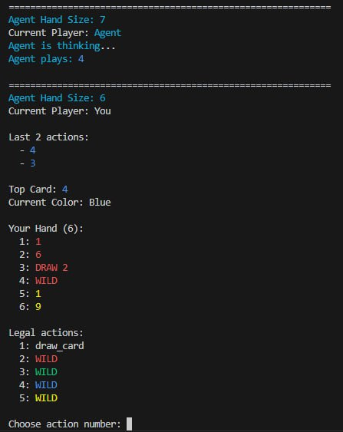
Project Screen shorts

Slide 9

Thank you!
I would like to express my heartfelt gratitude to Anshul Sarawagi Sir. for their invaluable support and guidance throughout the development of our project. His expertise, insights, and encouragement made this project possible.

